Slide 1
Python Basics

Slide 2
Python
Designed to be highly readable
No curly braces { }, uses indentation
No semi-colon ; when one instruction per line
Small core language, extensive libraries
Dynamic type system
Automatic memory management
Multi-paradigm: procedural, object-oriented, functional
Named for Monty Python

Slide 3
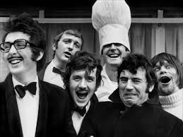
Basic Program Structure
"""
File: source.py
Description: A simple hello world program.
"""
# import any required modules
# function definitions
def main():
print ("Always look on the bright side of life")
# notice the indentation, it's mandatory
# auto-start code, if it's not being imported as a
# module
if __name__ == "__main__":
main()

Slide 4
Variables
Same naming rules as C++
No need to declare type
Can change type midway through code
def main():
x = "Eric Idle"
print(x)
x = 3.1415
print(x)

Slide 5
Basic IO
fave = input("Who is your fave Monty Python actor?")
print("My favorite is " + fave + " too!")
# notice the % as separator, not comma
print("My favorite is %s too!" % fave)
print() # blank line
print("Total number of cast members is", 3+3)
print("Strange women lying in ponds", end=" ")
print("distributing swords is", end=" ")
print("no basis for a system of government.")

Slide 6
Arithmetic Operators
Operator | Description | Example
+ | Addition | a = 5 + 10 # = 15
- | Subtraction | a = 5 - 10 # = -5
* | Multiplication | a = 5 * 10 # = 50
/ | Division (regular) | a = 5 / 10 # = 0.5
% | Modulus | a = 8 % 3 # = 2
** | Exponentiation | a = 5 ** 3 # = 125
// | Integer Division | a = 5 // 10 # = 0

Slide 7
String Operations
Many functions available for manipulating letters and strings:
str.isalpha, str.islower, str.isupper, …
str.lower, str.upper, …
letter = input("Enter a letter: ")
input("You entered an upper case letter: %d" % str.isupper(letter))

Slide 8
Functions and Parameters
# Euclid’s algorithm for computing GCD
def gcd(lg, sm):
if lg < sm:
lg, sm = sm, lg
# notice don't need a temp variable to swap
while sm > 0:
lg, sm = sm, lg%sm
return lg
def main():
x = 84
y = 154
ans = gcd(x,y)
print ("The GCD of %d and %d is %d." % (x, y, ans))
Notes:
Classic algorithm

Slide 9
Selection
fave = input("Who is your fave Python?")
# notice the : and indentation
if fave == "Michael Palin":
print("Mine Too!")
# notice it's 'elif' not 'else if'
elif fave == "John Cleese":
print("Totally Understandable!")
else:
print("Really?")
print("Just kidding %s rocks!" % fave)

Slide 10
Boolean Operators
Operator | Description | Example
== | Equal | 5 == 10 # False
!= <> | Not Equal | 5 != 10 # True 5 <> 10 # True
> >= | Greater Than Greater Than or Equal To | 5 < 10 # False 5 <= 10 # False
< <= | Less Than Less Than or Equal To | 5 < 10 # True 5 <= 10 # True
and | Logical And | x > 5 and x <= 5 # False
or | Logical Or | x > 5 or x <= 5 # True
not | Opposite (Logical Not) | x = True not x # False

Slide 11
Lists
More general than a C++ array
Can store items of different types
Can query length using len()
cheeses = ["Red Leister", "Tilsit", "Caerphilly", "Bel Paese", "Red Windsor", "Stilton", "Gruyere", "Emmental", "and", 36, "more"]
print (len(cheeses))
# access ‘slices’ of lists, more general than index
print (cheeses[5]) # can use like an index
print (cheeses[-1]) # can count from end ([-1] is last element, i.e. "more", [-2] is 36)

Slide 12
Slices
More powerful than index
cheeses = ["Red Leister", "Tilsit", "Caerphilly", "Bel Paese", "Red Windsor", "Stilton", "Gruyere", "Emmental", "and", 36, "more"]
print (cheeses[5:8]) # can access multiple elements, specifically items at positions 5, 6, 7: ["Stilton", "Gruyere", "Emmental"]
# can omit first or last index, and indicates rest
# of list
print (cheeses[5:]) # Stilton to end of list
print (cheeses[:-1]) # all but last item

Slide 13
Strings and Lists
Many list operators also apply to strings, e.g. len()
Slices useful for removing chars, e.g., trailing "\n" from line read in from file
# assume bird = "African Swallow\n"
bird = bird[:-1];
Can explicitly convert between using list() and join()
listOfLetters = list("African Swallow\n")
word = "".join(listOfLetters)

Slide 14
Strings
Can’t overwrite individual letters in a string, as would with a character array:
bird = "African Swallow" bird[1] = "a"
Instead must take slices and create new string bird = "African Swallow" bird = bird[:1] + "a" + bird[2:]
Notes:
Strings are an immutable type

Slide 15
Membership Operator
Can test whether an item is/isn’t in a list/string
order = input("What would you like to eat?")
# commonly used with lists
menu = ["egg and spam", "egg, bacon and spam", "egg, bacon, sausage and spam", "spam, bacon, sausage and spam", "spam, egg, spam, spam and bacon"]
if order in menu:
print("Right-o!")
# also works with strings
if "spam" not in order:
print("We only have %s and spam." % order)
else:
print("I'll get right on that")

Slide 16
Randomness
Need to import random library
Seeds automatically using system time
import random
def main():
# uniform distribution options:
print(random.random()) # float in range 0-1
print(random.randint(1,10)) # int in range 1-10
print(random.randrange(0,10,2)) # random even integer in range 0-10
# normal distribution:
mean = 1; stddev = 0.8
print(random.normalvariate(mean,stddev))

Slide 17
Randomness
import random
def main():
parrotAdjs = ["dead", "demised", "passed on", "no more", "ceased to be", "expired", "gone to meet his maker", "a stiff", "bereft of life", "rests in peace", "off the twig", "kicked the bucket", "shuffled off his mortal coil, run down the curtain and gone to join the choir invisible", "an ex-parrot"]
print("He's %s" % random.choice(parrotAdjs))
random.shuffle(parrotAdjs) # now in random order

Slide 18
Loops
Has standard while and for loops
Also has standard break and continue
Loops are more flexible than C++ equivalents
Parentheses not required on condition
While and For loops can have an else clause
For loop has convenient counting options

Slide 19
While Loop
Optional else clause can be added to handle case where loop doesn’t run at all.
answer = input("Who plays Brian in 'Life of Brian'? ")
while answer != "Eric Idle":
print("Not Quite!")
answer = input("Who really plays Brian? ")
else:
print("Got it in one!")

Slide 20
For Loop
A variety of convenient counting options available:
parrotAdjs = ["dead", "demised", "passed on", "no more", "ceased to be", "expired", "gone to meet his maker", "a stiff", "bereft of life", "rests in peace", "off the twig", "kicked the bucket", "shuffled off his mortal coil, run down the curtain and gone to join the choir invisible", "an ex-parrot"]
for adj in parrotAdjs:
print("This parrot is %s" % adj)
for letter in "TIGERS":
print("Gimme a %c! %c!" % (letter, letter))

Slide 21
For Loop with Range Function
for num in range(10):
print(num) # 0…9
for num in range(5,10):
print(num) # 5…9
parrotAdjs = ["dead", "demised", "passed on", "no more", "ceased to be", "expired", "gone to meet his maker", "a stiff", "bereft of life", "rests in peace", "off the twig", "kicked the bucket", "shuffled off his mortal coil, run down the curtain and gone to join the choir invisible", "an ex-parrot"]
for index in range(len(parrotAdjs)):
print("This parrot is %s" % parrotAdjs[index])

Slide 22
File IO
# write to a file
file = open("data.txt", "w")
for num in range(10):
file.write("%f \n" % random.random())
file.close()
# read from file
file = open("data.txt", "r")
for line in file:
print(line)
file.close()
# alternative read from file
file = open("data.txt", "r") data = file.readlines()
for line in data:
print(line)
file.close()

Slide 23
Time
Simple Option: subtract end time from start time: import time … start = time.time() myFunc() end = time.time() print("myFunc took %f secs" % (end-start)) # time.perf_counter() considered more accurate # time.process_time() excludes sleep time

Slide 24
Time
Better Option: consider multiple runs: import timeit … elapsed = timeit.timeit(myFunc) print("%f secs to run 1000000 times" % elapsed) # can change number of repetitions elapsed = timeit.timeit(myFunc, number=100) print("%f secs to run 100 times" % elapsed) # can get multiple samples print(timeit.repeat(myFunc, number=100, repeat=3)) # min of the 3 values is considered most accurate # variance is due to other processes

Slide 25
Lab 1: Limited Hangman
Hint: if there is a function you need that wasn’t covered, e.g. sorting, substring, intersection, etc., feel free to consult Google. Python has a lot of available functionality.

Slide 26
Pycharm IDE for Python

Slide 27
Installing
You will need to download a Python 3.5 interpreter from: https://www.python.org/downloads/
And then install the Pycharm Commuity Edition IDE, available from: http://www.jetbrains.com/pycharm/download/

Slide 28
Pycharm
Provides a convenient environment for coding and debugging in Python
Color coding
Function suggestions
Debugging tools

Slide 29
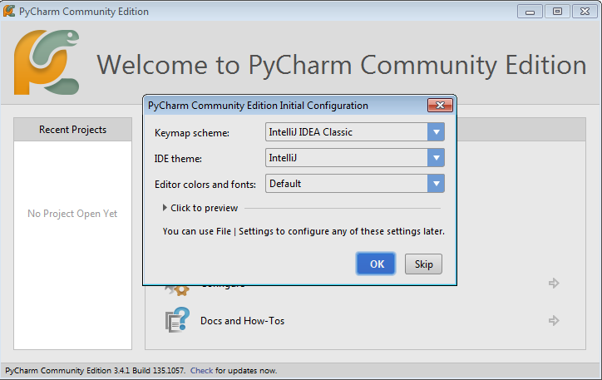
Running Pycharm
First time opening, may be asked to confirm config.

Slide 30
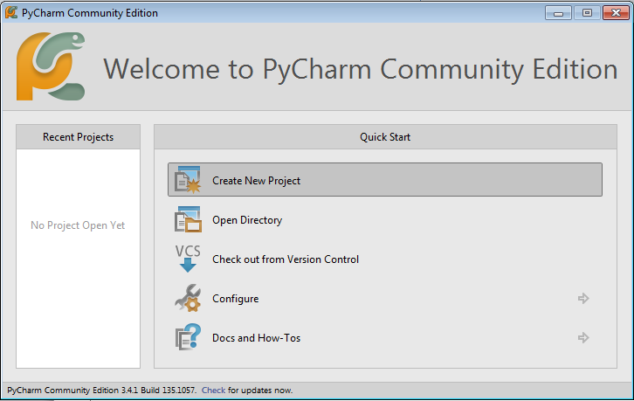
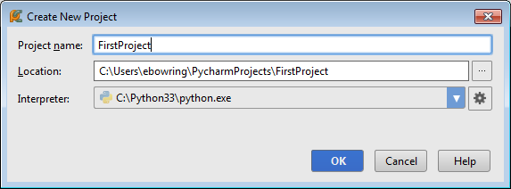
Creating a Project

Slide 31
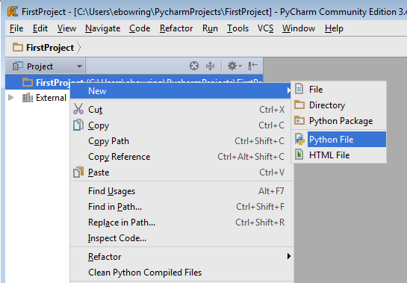
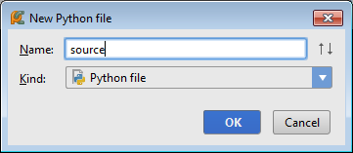
Adding a Source File

Slide 32
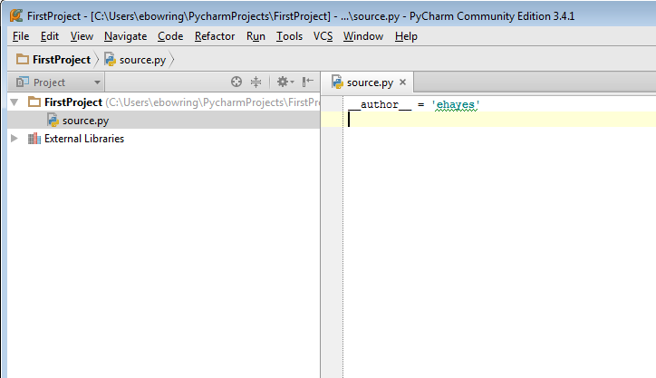
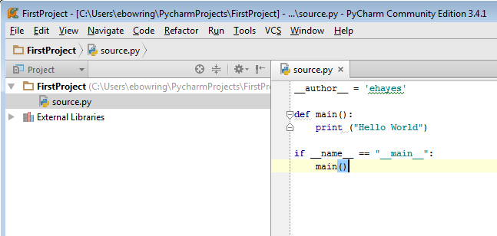
Editing Your Code

Slide 33
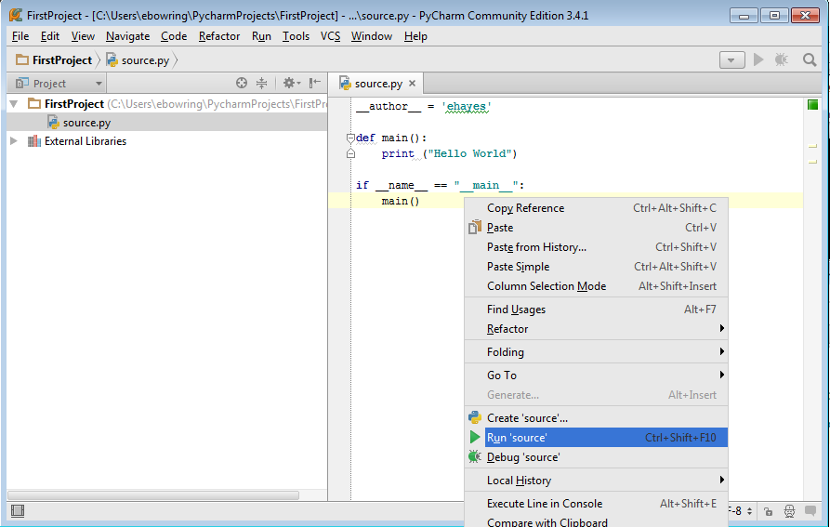
Running Your Code

Slide 34
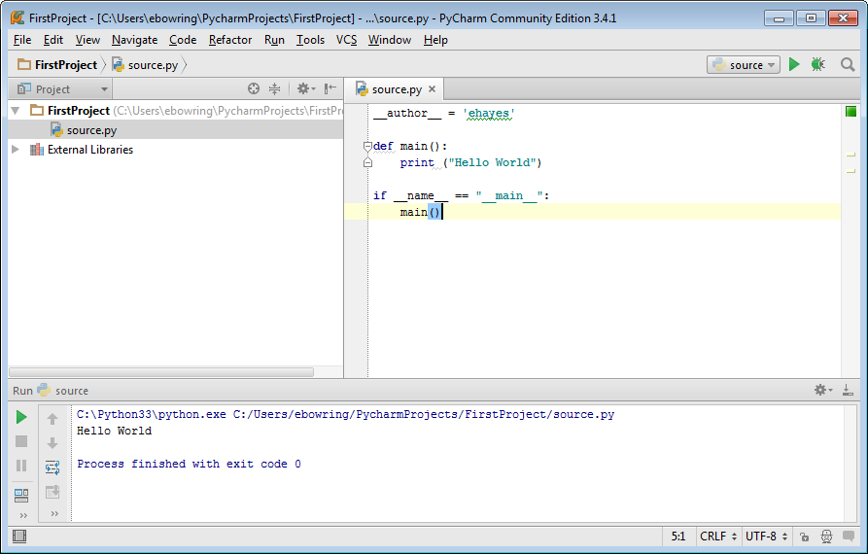
Running Your Code

Slide 35
Debugging Tools
Pycharm provides all the standard debugging tools:
Breakpoints
Ability to step through code, instruction by instruction
Ability to watch variables

Slide 36
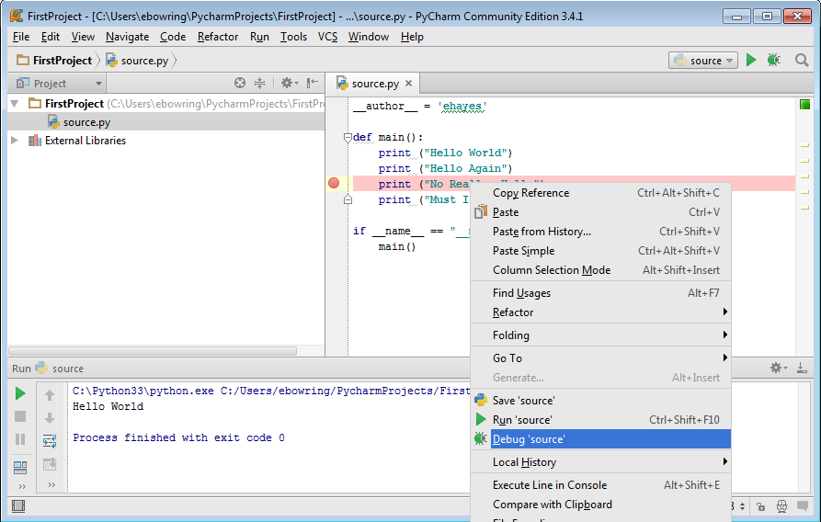
Breakpoints

Slide 37
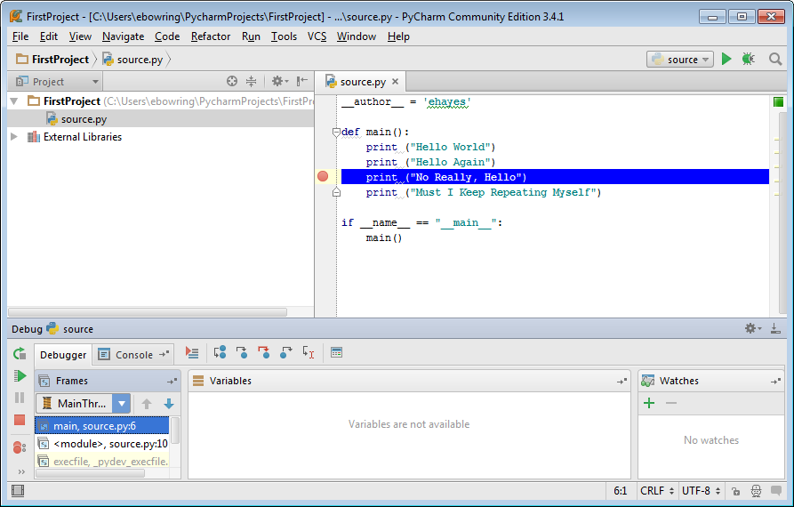
Watching Variables

Slide 38
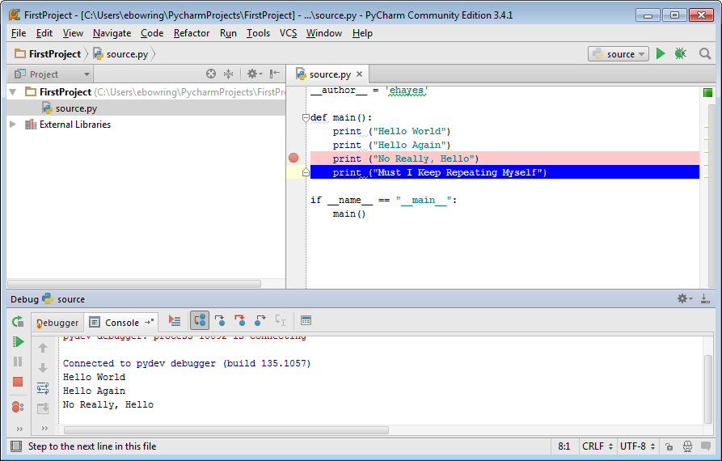
Stepping Through Code

